Slide 1

Partially&Tubular Shape Tissues Segmentation in Medical Image
Qin Wang
wangqin4377@qq.com
http://www.qinwang.blog

Slide 2
﻿Prior-aware Neural Network for Partially-Supervised Multi-Organ Segmentation
﻿Yuyin Zhou1∗† Zhe Li2 ﻿Alan L. Yuille1
﻿Johns Hopkins University

Slide 3
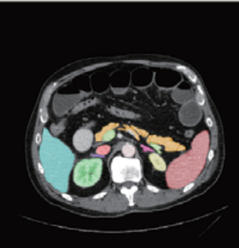
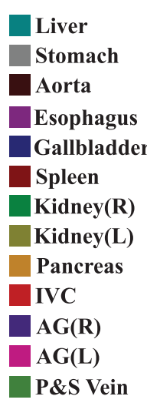
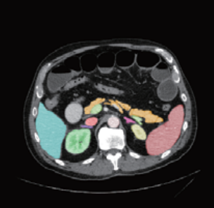
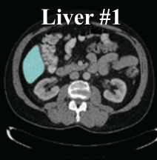
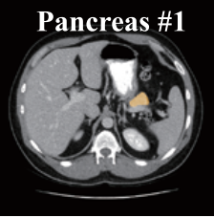
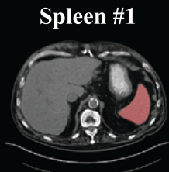
Problem Definition
Abdominal Multi-organ Segmentation﻿(Abdomen dataset: 30 pixel wise labeled CT scans, 13 organs)
﻿Partially Abdominal Multi-organ Segmentation﻿

Slide 4
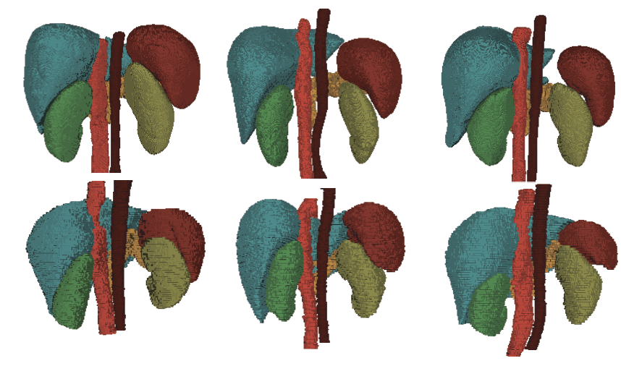
Intuition
No Previous work. Semi-supervise method won’t work(Mislead the training)
﻿Anatomical similarities between different patients

Slide 5
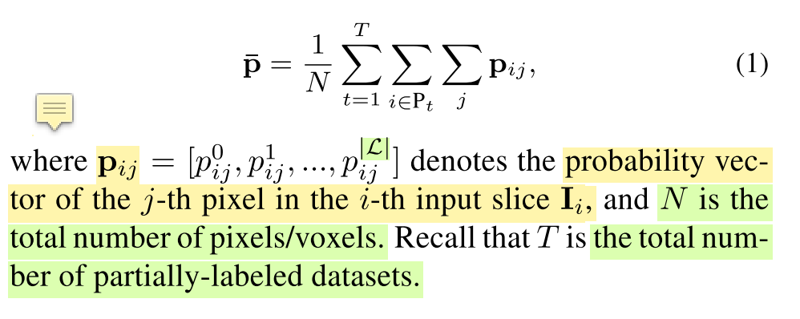
Method
Using pretrained model to generate pseudo label
Step1 Train on the small fully labeled dataset
Step2 Generate pseudo label for partial labeled dataset
Step3 Using all data to train the network
﻿Prior-aware Loss ﻿is used as a soft global constraint to stablize the training process
Organ size distribution of each dataset should be same
p_{i,j} is a one hot-like vector

Slide 6
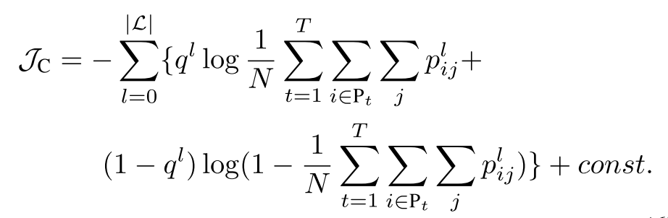
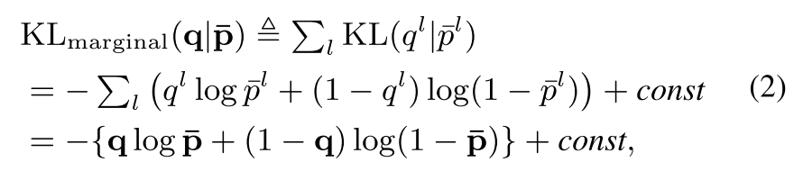
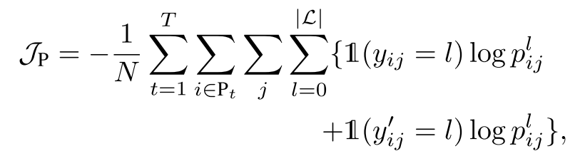
Method
﻿ Naive Prior-aware Loss
Cross Entropy Loss

Slide 7
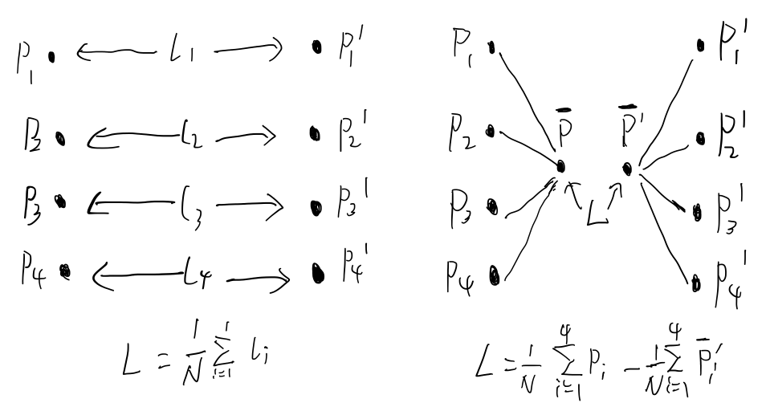
Method
﻿ Naive Prior-aware Loss
Cross Entropy Loss

Slide 8
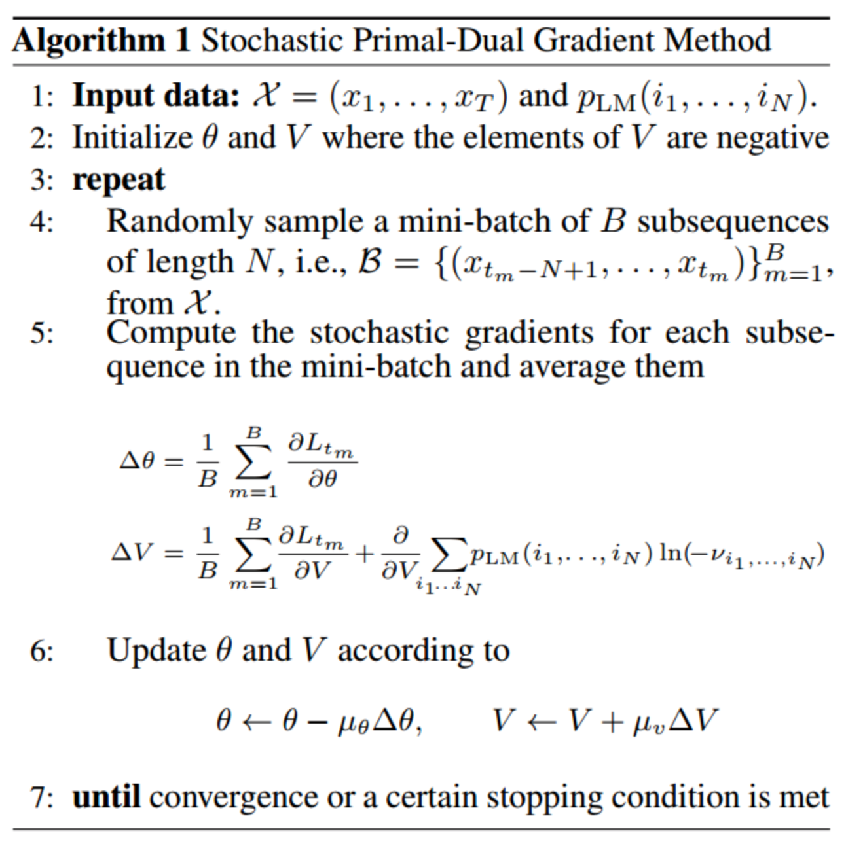
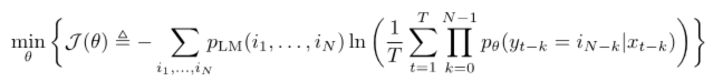
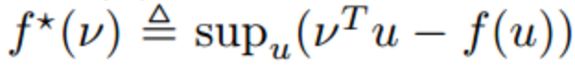
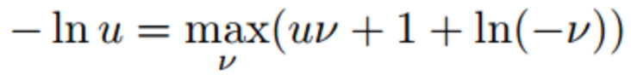
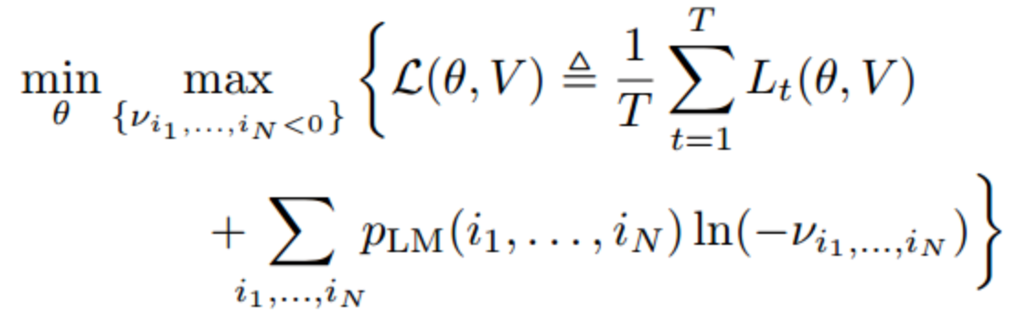
SPDG: stochastic primal-dual gradient
﻿ “An Unsupervised Learning Method Exploiting Sequential Output Statistics” Li Deng, NIPS2017
Convex conjugate function for f(x)
https://www.jianshu.com/p/0c962ca8286b

Slide 9
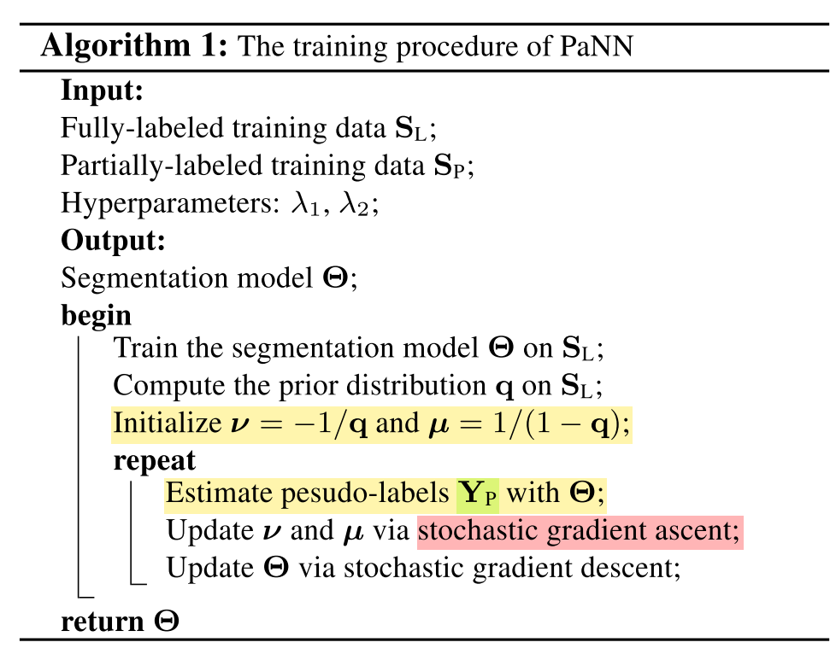
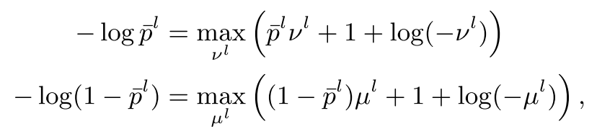
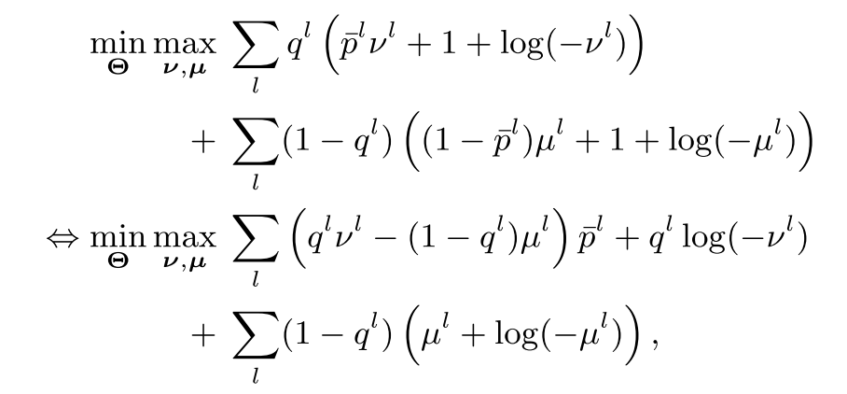
Method
﻿ Prior-aware Loss in Prime-Dual Gradient

Slide 10
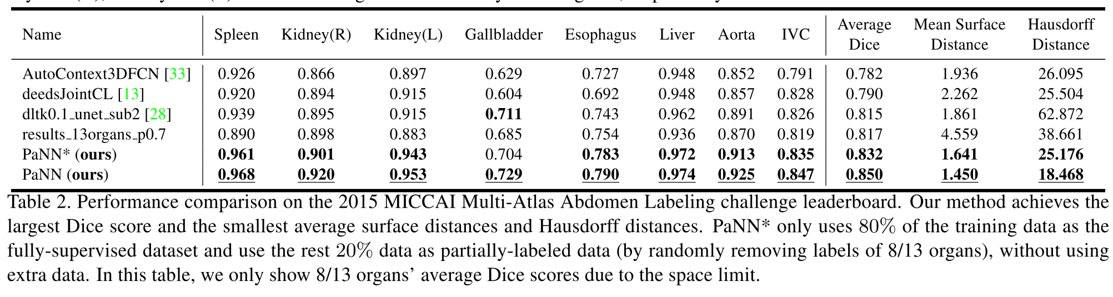
Experiment

Slide 11
﻿AirwayNet: A Voxel-Connectivity Aware Approach for Accurate Airway Segmentation Using Convolutional Neural Networks
﻿ ﻿Yulei Qin1,2, Mingjian Chen1 ﻿Guang-Zhong Yang ﻿
Shanghai Jiao Tong University

Slide 12
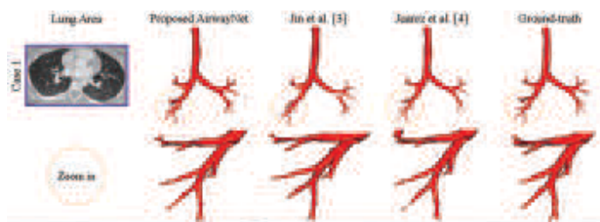
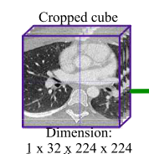
Problem Definition & Intuition
Segment Airway from Lung CT Scan
Insight
﻿Considering that the tree-like structure of airway is rather complex and the prediction of airway candidates is prone to discontinuity, we put emphasis on the connectivity of airway voxels.

Slide 13
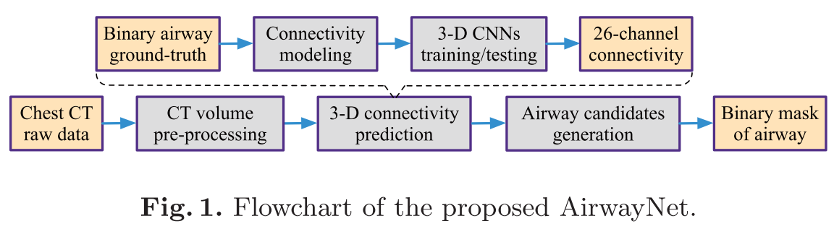
Method
﻿Unlike previous methods, we do not directly train the network to classify foreground and background voxels. Instead, binary segmentation task is transformed into 26 tasks of predicting whether a voxel is connected to its neighbors
﻿The proposed AirwayNet automatically learns relationship between adjacent voxels and discriminates airway from the background.
For each voxel, the network predicts not only its probability of being airway but also its connectivity to neighbors.
Modeling a new data-format to represent pixelwise ground truth which contains connectivity information

Slide 14
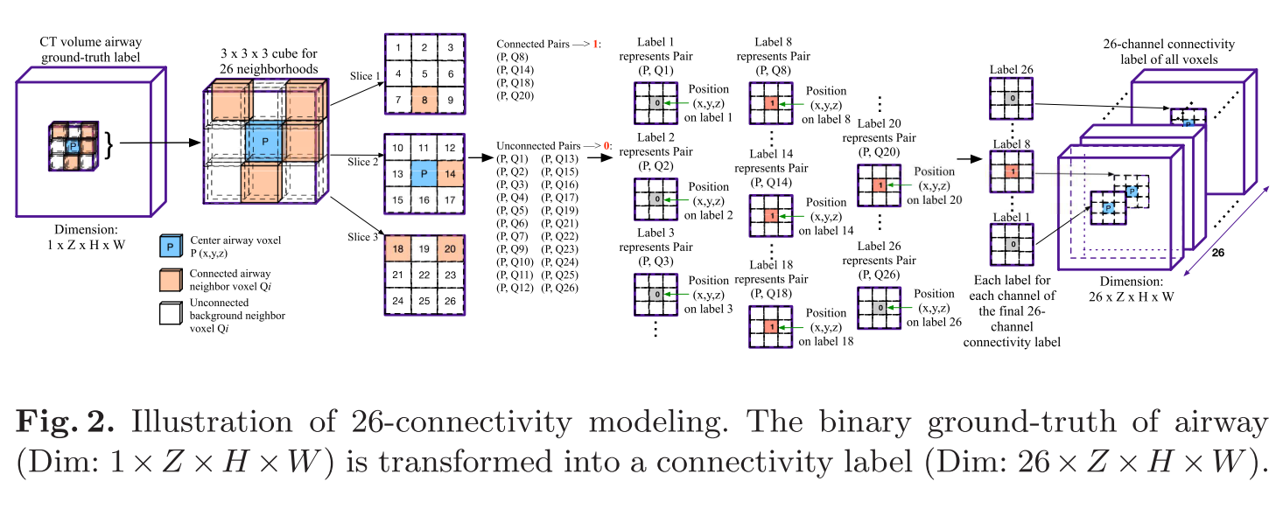
﻿Connectivity Modeling
﻿Index neighbors Q from 1 to 26 and denote each voxel pair (P, Qi), i ∈ {1, 2, ..., 26} as a connectivity orientation.
﻿If both P and Qi are airway voxels, then the pair (P, Qi) is connected and the corresponding position “P” on the i-th label is marked as 1. Otherwise, we mark 0 on the i-th label to represent disconnected pair (P, Qi).

Slide 15
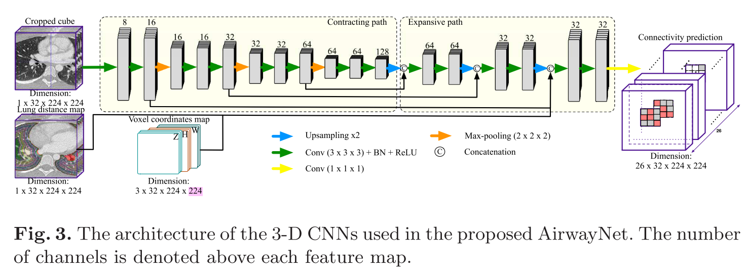
Method

Slide 16
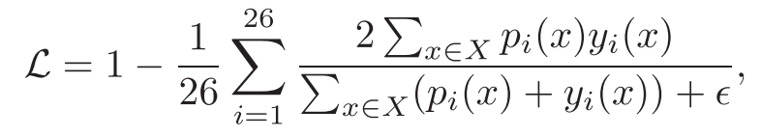
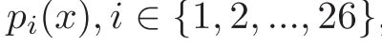
Method
﻿The sigmoid function is applied on the predicted connectivity cube to obtain probability distribution.
﻿We use the Dice similarity coefficient (DSC) loss to optimize our AirwayNet.
﻿Airway Candidates Generation
Step 1 ﻿A threshold t = 0.5 is used to binarize prediction results
Step 2 ﻿If voxel P is connected to its neighbor Q14 (see Fig. 2), then voxel P on the 14-th connectivity channel is marked as 1. Meanwhile, on the 13-th channel, voxel Q14 is marked as 1
﻿Step 3 The segmentation results are multiplied with the lung field mask to filter out false positives.

Slide 17
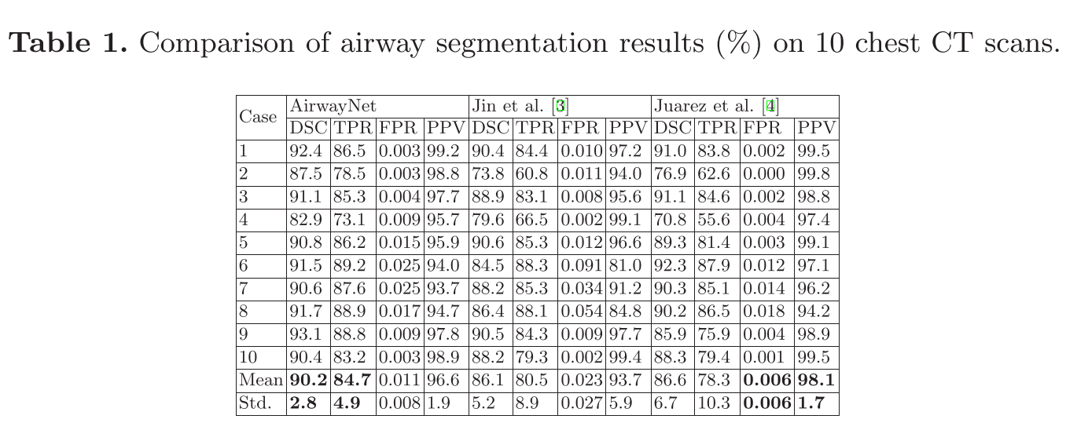
Experiment

Slide 18
﻿Deep Distance Transform for Tubular Structure Segmentation in CT Scans
﻿ ﻿Yan Wang1† Yuyin zhou ﻿Alan L. Yuille
﻿Johns Hopkins University

Slide 19
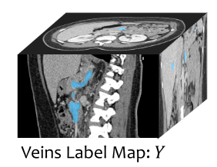
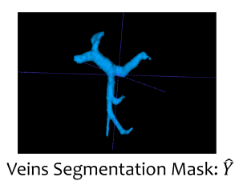
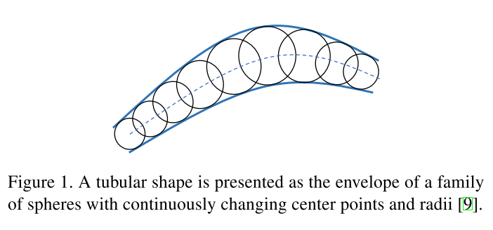
Problem Definition & Intuition
﻿Tubular structures: ﻿blood vessels, pancreatic duct and urinary tract.
﻿Geometry-based methods, a tubular structure can be well represented by its skeleton and radii it has a cylindrical surface
﻿Cannot deal with poor contrast, noise and complicated background
﻿Learning-based methods, which learn a per-pixel classification model to detect tubular structures
﻿These networks simply try to learn a class label per voxel and ignores the geometric arrangement of the voxels in a tubular structure and can not guarantee that the obtained segmentation has the right shape

Slide 20
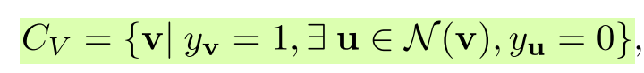
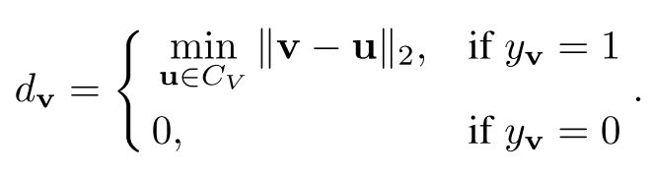
Method
﻿A method to predict segmentation mask for a tubular structure, but also a distance map
﻿Distance Map
Each value in which is the distance from each foreground pixel/voxel to the foreground boundary
﻿The ridge of the distance map is the skeleton
﻿A geometry-aware approach to refine the output segmentation mask by leveraging the shape prior reconstructed from the distance map.
﻿Taking the geometric property of tubular structures into account.
Distance Map Generation
﻿Let Cv be the set of voxels on the tubular structure surface
﻿Generate distance map D and ﻿further quantize each dv into one of K bins, ﻿converts the continuous distance map D to a discrete quantized distance map Z, where zv ∈ {0, . . . ,K}.

Slide 21
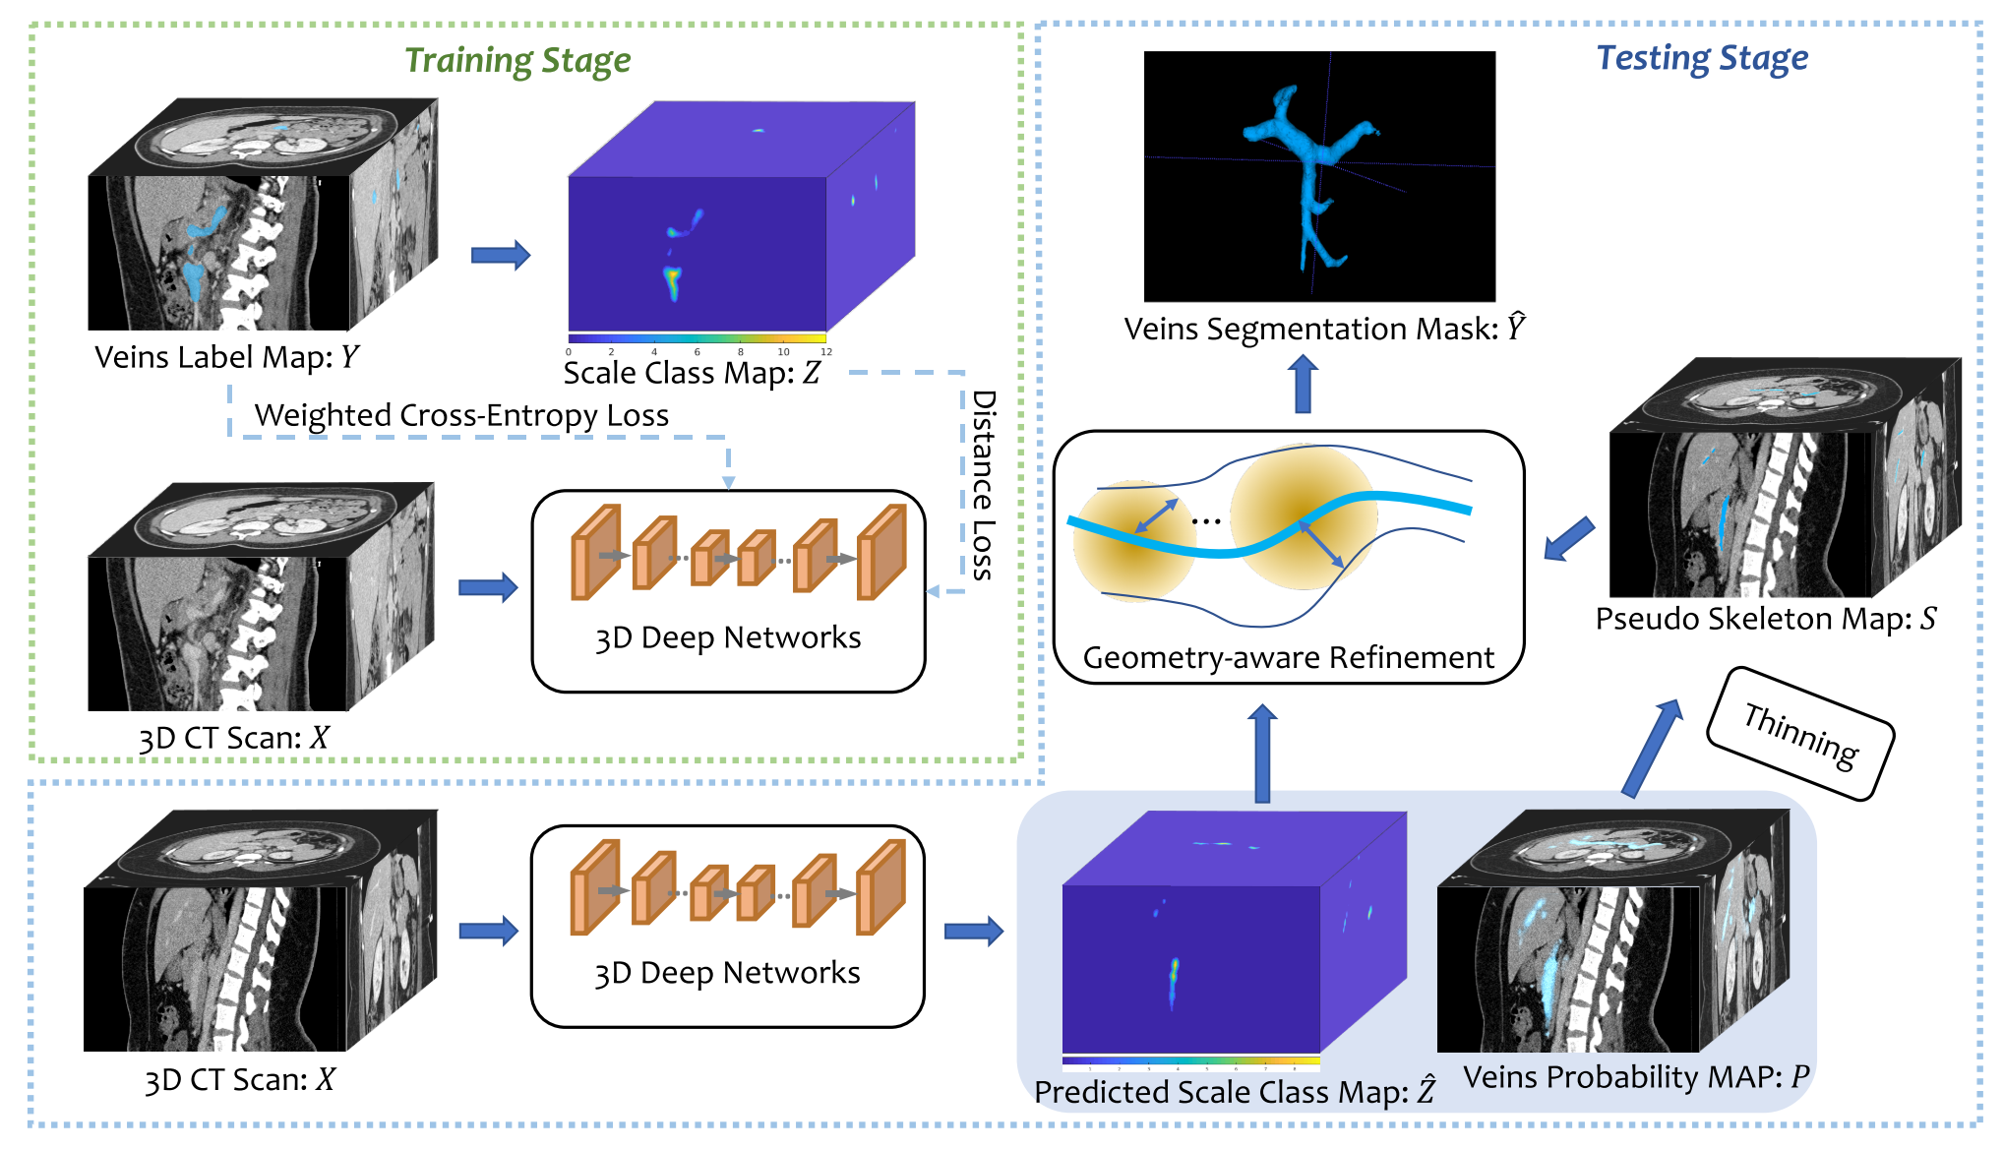
Pipeline

Slide 22
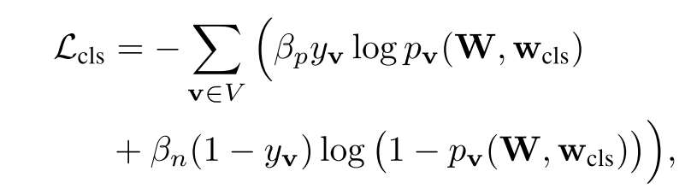
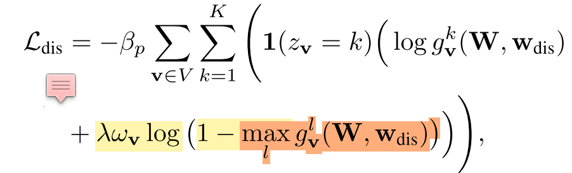
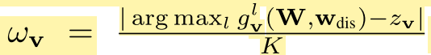
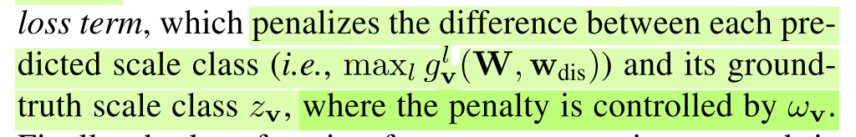
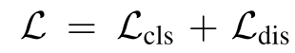
Loss Function

Slide 23
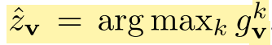
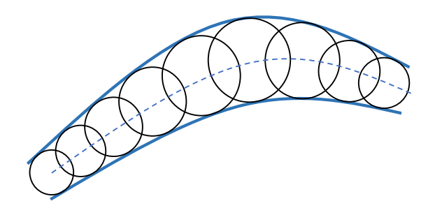
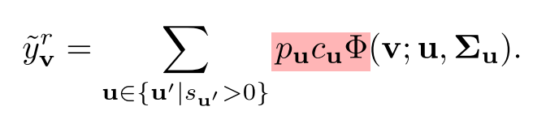
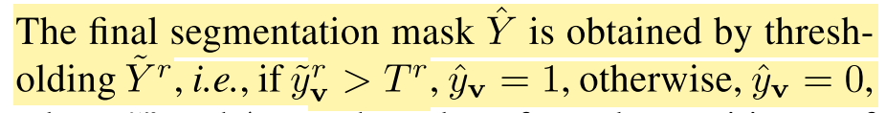
﻿Geometry-aware Refinement
﻿Step1: Pseudo skeleton generation. The probability map P is thinned by thresholding it to generate a binary pseudo skeleton map S (centerline) for the tubular structure.
﻿If pv > Tp, sv = 1; otherwise, sv = 0
Step2: ﻿Shape reconstruction. For each voxel v, its predicted scale z_v is given by
Step3: ﻿Segmentation refinement. Using the soft reconstructed shape Y˜ s to refine the segmentation probability p_u.

Slide 24
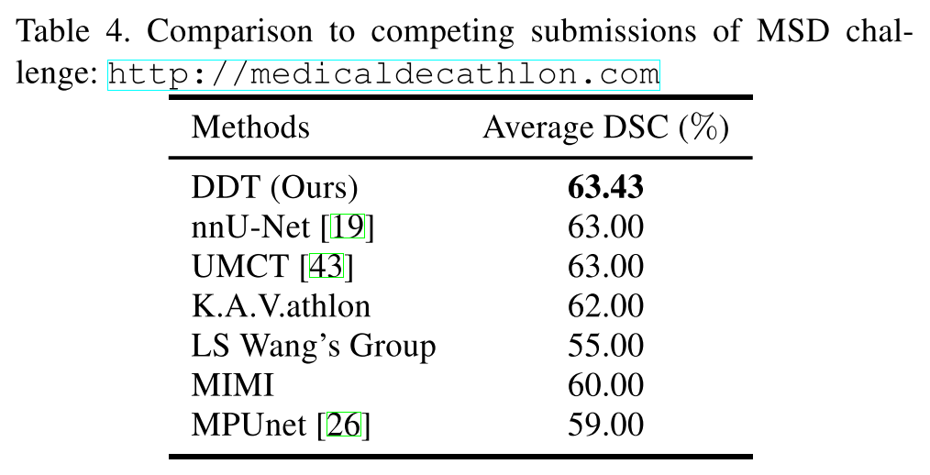
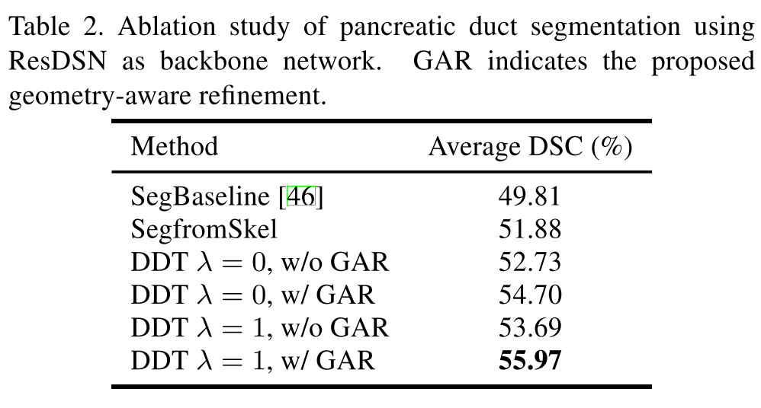
Experiment
﻿Hepatic Vessels Dataset in MSD Challenge

Slide 25
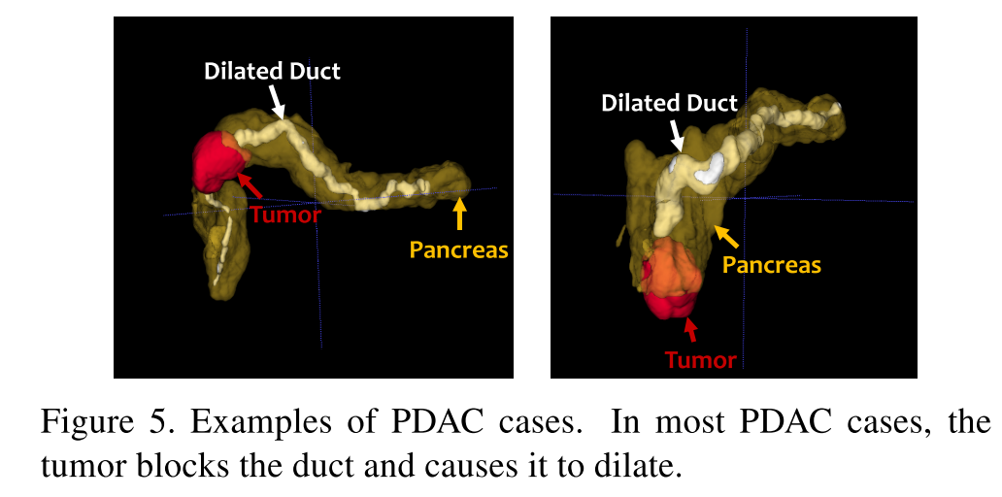
﻿Finding PDAC Tumor by Dilated Duct
﻿State-of-the-art deep network failed to detect 8 PDACs out of 136 abnormal cases while ﻿for clinical purposes, we shall guarantee a high sensitivity.
﻿We use dilated duct as a cue to help find the PDAC tumor in an abnormal case even if it does NOT have any PDAC tumor prediction
﻿Dilated duct helps us to narrow the searching space of the tumor

Slide 26
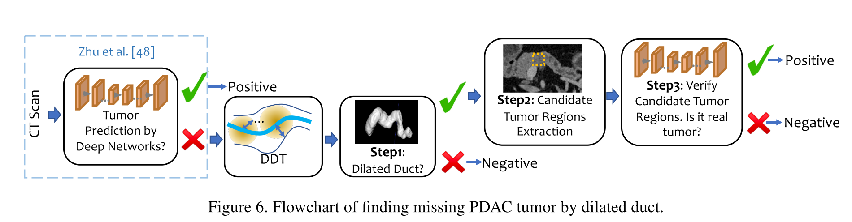
﻿Finding PDAC Tumor by Dilated Duct
Step 1: ﻿Find cases with predicted dilated duct
Step 2: ﻿Extract candidate tumor regions by the location of dilated duct
Step 3: ﻿Verify candidate tumor regions

Slide 27
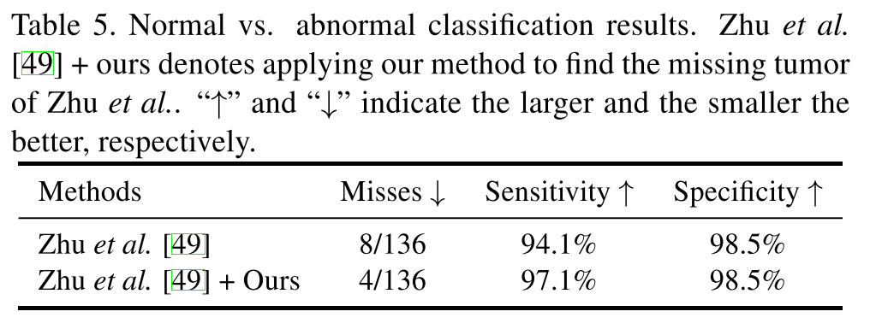
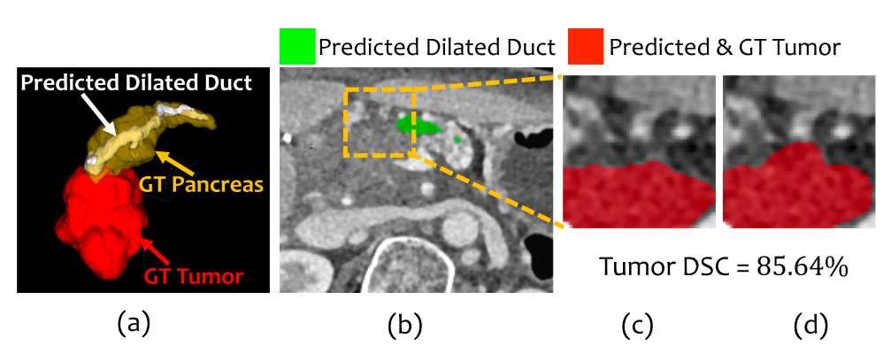
﻿Finding PDAC Tumor by Dilated Duct

Slide 28
Thanks

